Slide 1
Introduction to Technical Report Writing

Slide 2
Example of Free Writing
The best of both worlds is nowhere. Could you ever imagine something terrible and best all at the same time. I’m talking about the guest speaker in the recent seminar I attended. Was it a seminar? Hmmmm I mean lecture. (sigh) Whatevah! Going back... The thing is, nothing can ever tell me.

Slide 3
Conversion to Technical Writing
Single out terms used in Paragraph i.e., LECTURE and SEMINAR
“A lecture is an oral presentation intended to present information or teach people about a particular subject, for example by a university or college teacher. On the other hand, a seminar is, generally, a form of academic instruction, either at a university or offered by a commercial or professional organization. It has the function of bringing together small groups for recurring meetings, focusing each time on some particular subject, in which everyone present is requested to actively participate”.

Slide 4
Difference between Technical and Creative Writing
Creative Writing | Technical Writing
To evoke images and emotion Descriptive words used to create setting and/or image Emphasis Character and character development Subjective Content General e.g., Novels | To communicate facts, explain procedures, critically evaluate evidence Conciseness encouraged and valued Emphasis facts, accuracy, precision Objective Content Specific e.g., Owners Manual

Slide 5
Introduction to Technical Writing
One of the main forms of communication in engineering is the technical report. In the workplace, the report is a practical working document written by engineers for clients, managers, and other engineers.
Primary aim is to communicate a particular piece of information for a particular purpose to a particular reader or group of readers. E.g., Product Manuals.

Slide 6
Purpose of Technical Writing
Give information that leads to accomplishments of scientific tasks and in the making of needed decisions.
The two main purposes
Analyse events and their implications
Persuade and influence the decisions

Slide 7
Properties of Report Writing
Clarity: Technical document must convey a single meaning that the reader can understand. Unclear Technical writing is expensive and can have cost and consequences. E.g. unclear instruction on how to operate machinery.
Accuracy: The subject matter is to be crafted with utmost care and presented orderly otherwise entire document becomes questionable. E.g., If you mean to write 40,000 don’t write 400,000.

Slide 8
Properties of Report Writing(Cont)
3. Comprehensiveness: When writing technically, all the information should be provided, its background must be described and clear description of any process, or method of carrying out a specific work, should also be given. It also includes results, conclusions and recommendations.
4. Accessibility: It means the ease with which the readers can locate the information they seek. To increase Accessibility, include headings and lists in the report. A table of contents, list of illustrations glossary and index are preferred.

Slide 9
Properties of Report Writing(Cont)
5. Conciseness: Technical writing is meant to be useful. The longer a document is, the more difficult it gets to use it. Even it takes more of the user's time.
6. Correctness: Qualities of technical report writing also includes correctness. Good technical report must also be correct. It. Must be free from grammatical errors, punctuation mistakes, and should have appropriate format standard. If a report contains grammatical errors, the reader will doubt the accuracy of the information in the report.

Slide 10
“Activity 1”

Slide 11
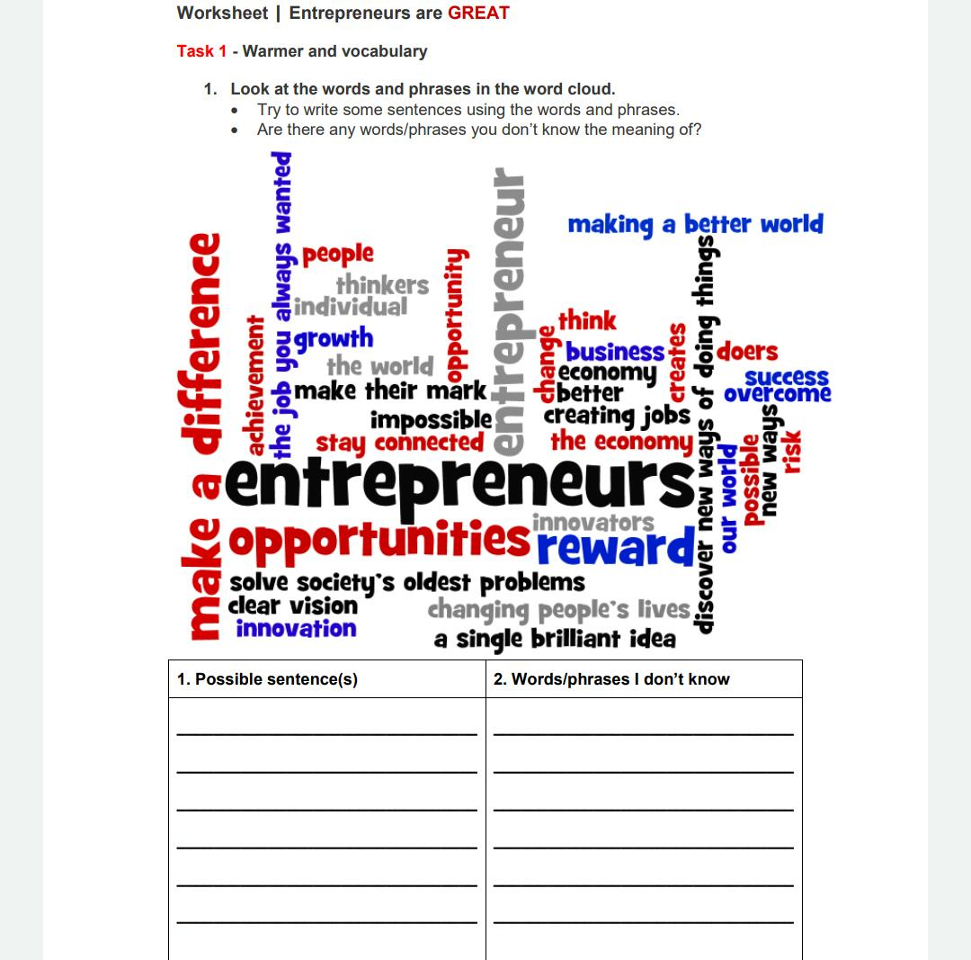

Slide 12
“ACTIVITY 2”

Slide 13
“Illiteracy is a problem in many of the world’s poorest countries. Even in wealthier nations like the United States, many children struggle with reading and writing. But in 19 cities across the country [United States], the volunteers of Experience Corps are helping youngsters learn to read. The volunteers, all over 50, work with students in low-income areas.” (Older Volunteers Help Children Learn to Read, Voice of America, voanews.com)

Slide 14
Answer…
Older Experience Corps volunteers help poor children from 19 US cities improve their literacy skills.

Slide 15
“Activity 3”
Your first assignment is to write about yourself-about your own intellectual interests and passions. In particular, I would like you to address the question: What scientific or technological issues, questions or problems most deeply interest you, and how do you think those interests will shape your life?

Slide 16
ANY QUESTION???

